Slide 1


EaseTrade
One Solves All …
Rebecca Zhang

Slide 2

Dilemmas in Our Lives
Hard to set reasonable prices for the goods one wants to sell
Inconvenient to write a concise message describing the good
Difficult to reach potential buyers within one’s social range

Slide 3






What if …

Slide 4

My Solution --Totally from Scratch
Data scraped of the Current Market from eBay
Powerful Calculator for Setting Prices
User-friendly Graphic User Interface
Convenient Trading with Connection to Facebook

Slide 5
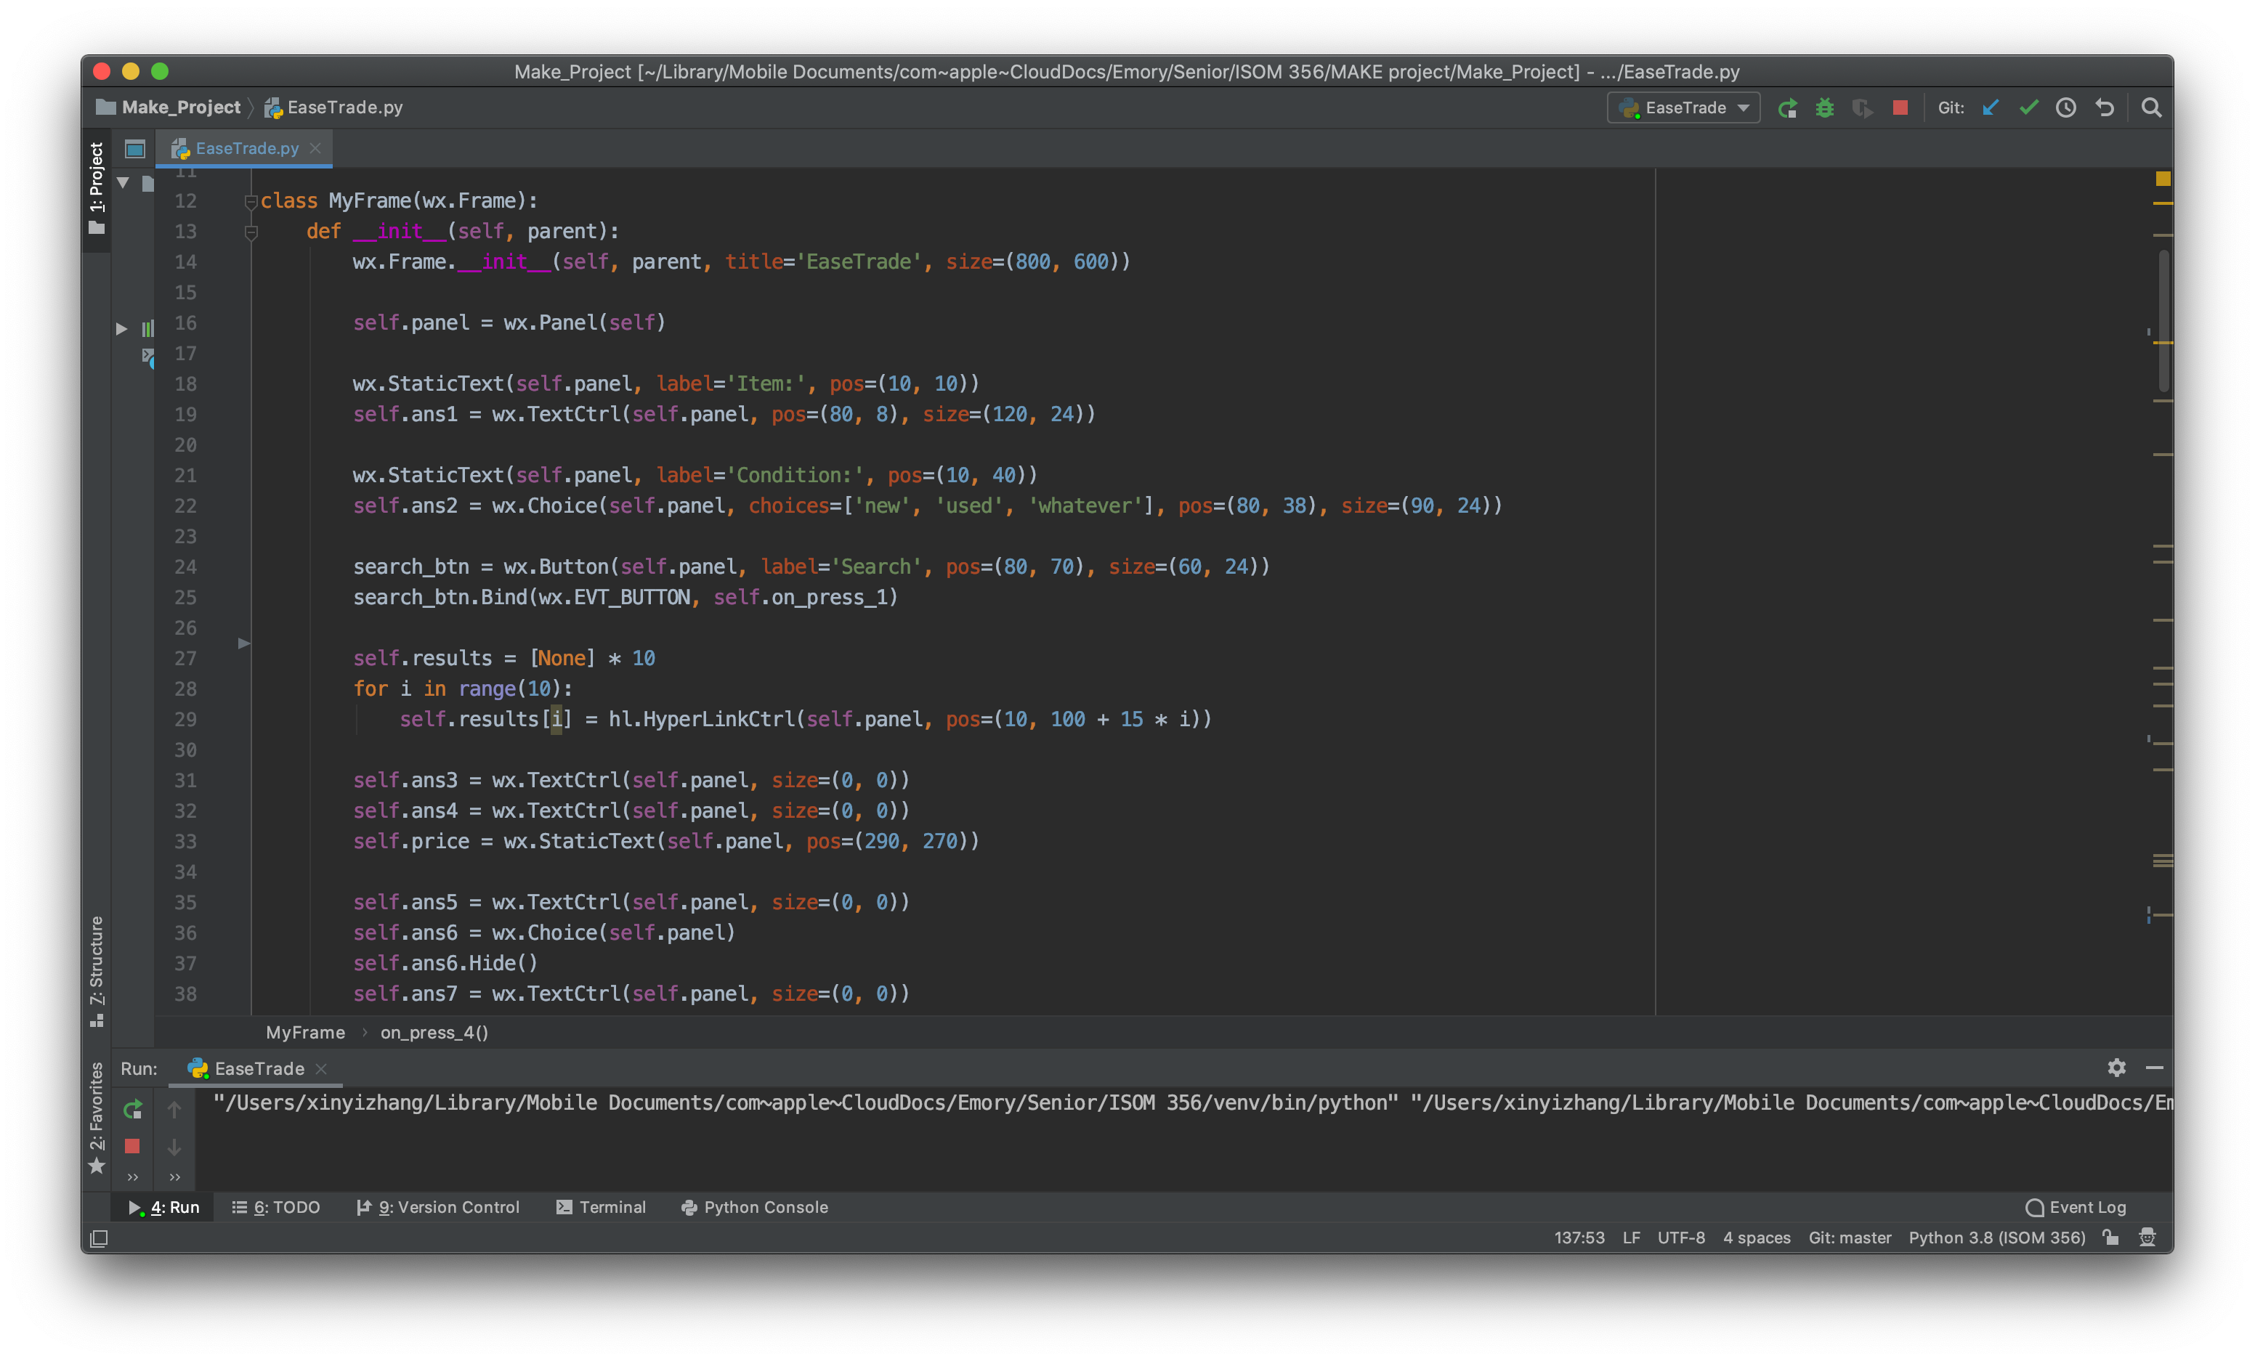
Design
Programming with GUI utilizing data obtained through the eBay API

Slide 6
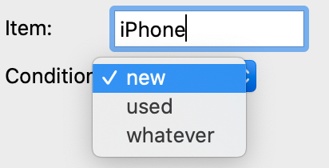
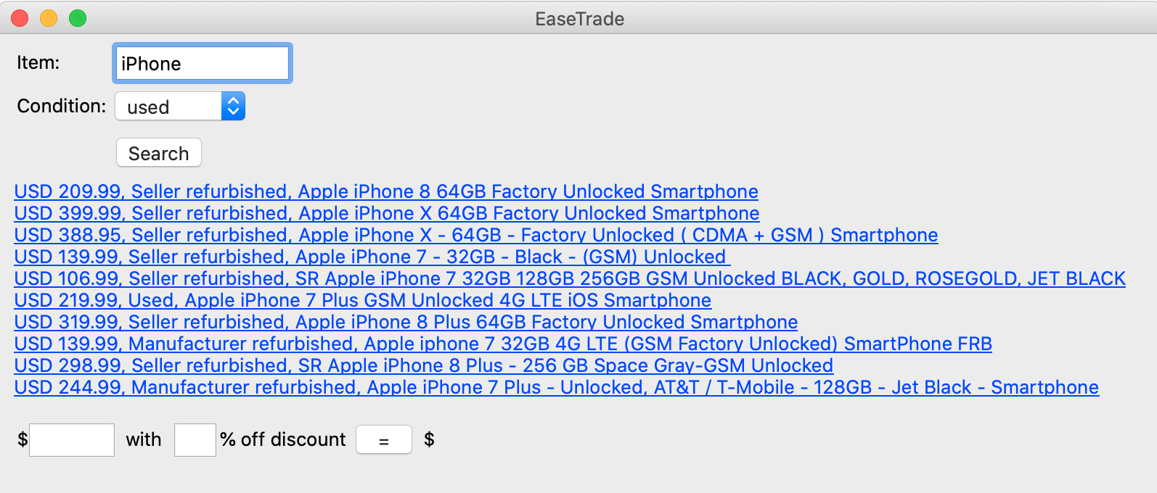
Implementation
You could put any items and choose the condition
The system will generate the price of a list of most relevant items

Slide 7
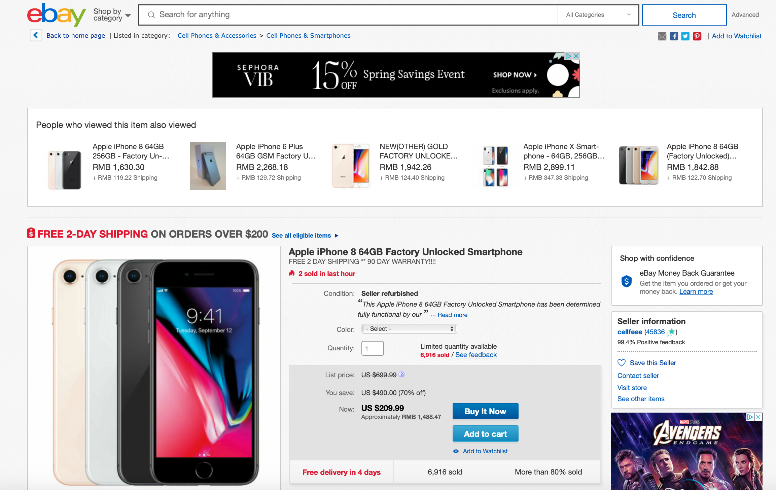
Implementation
You could click the links and see the picture and information of the goods similar to what you want to sell.

Slide 8
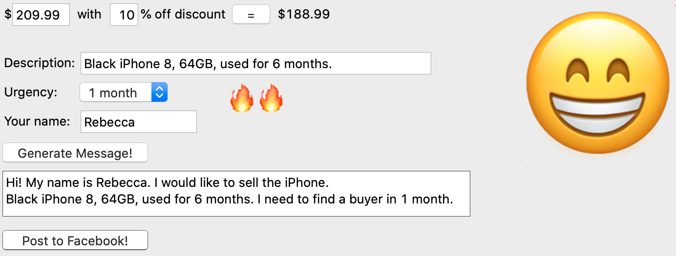

Implementation
The system easily calculates the price with the discount you input.
You can put concise description and urgency level based on your need.
The system will automatically generate a complete message ready to be posted on your social media.

Slide 9


Highlights
Flexible drop-down menus and functional pressed-down buttons implemented using the wx package
Urgency level (want to sell the item within…)
1 week
1 month
> 1 month
Message is automatically copied to the clipboard, ready to be posted on Facebook, implemented using the pyperclip package
🔥🔥🔥
🔥🔥
🔥

Slide 10
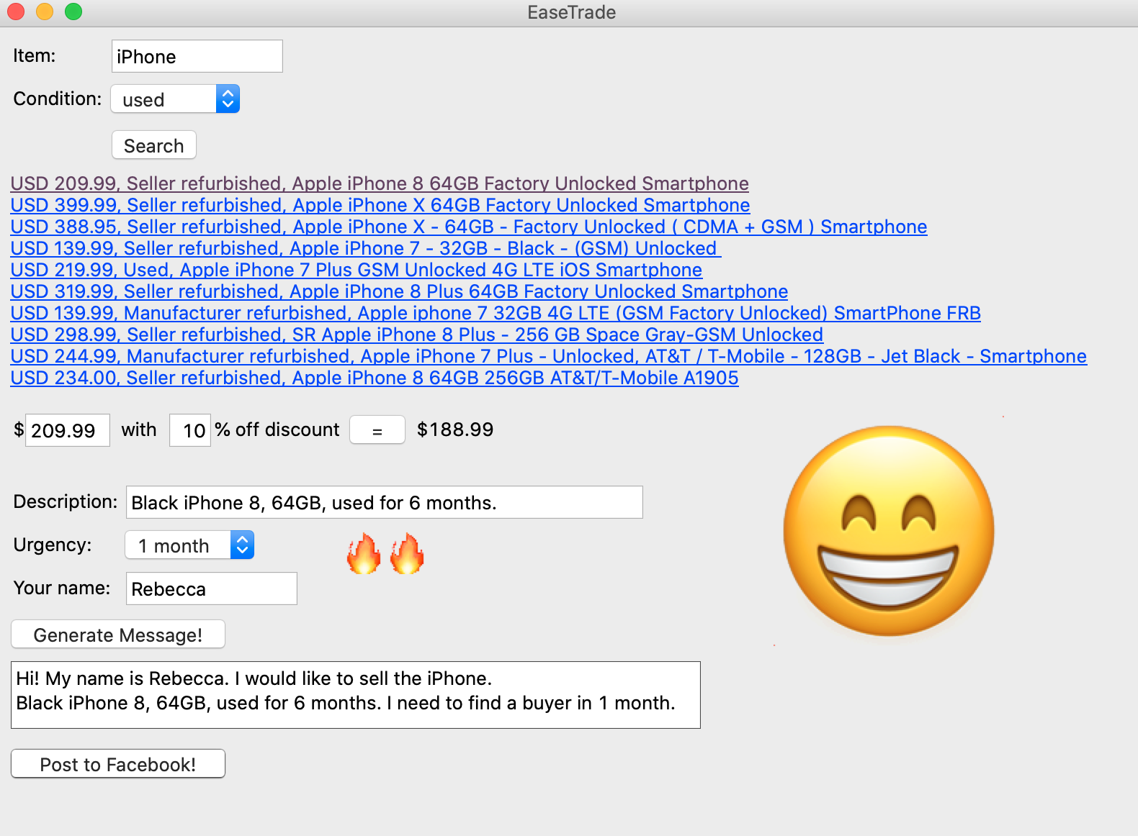
Overall Visualization

Slide 11
Application Scenarios
Relocation
Graduation, job change, etc.
Extra Earning
Surplus items
Renovation
Clean-up

Slide 12

To be Continued
I would like the users to be able to register individual accounts stored on a secure database by
Establishing online forums where different institutions, such as companies and colleges, have their own online communities
Adding more features and collaborating with various social media platforms to create further opportunities

Slide 13

Thank You!

